Slide 1

Deployment Project
HENRY GIORGI
Data Science Bootcamp

Slide 2
Goal
Automate the loan eligibility process.

Slide 3
Features
Loan: Amount and term
Income: Applicant and Coapplicant
Dependents
Education
Credit History
Property Area

Slide 4
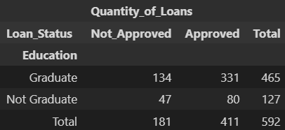
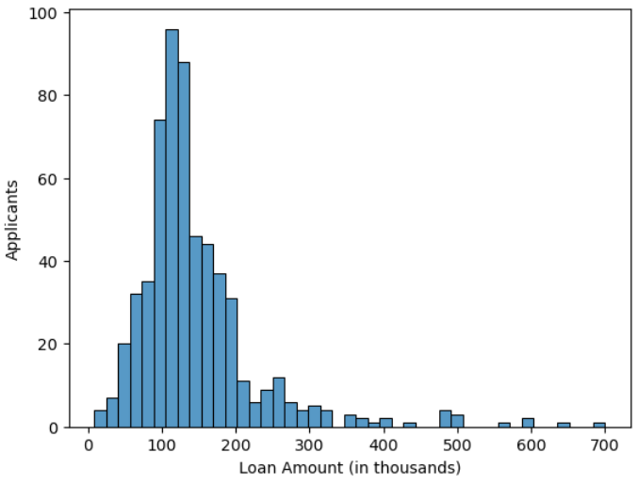
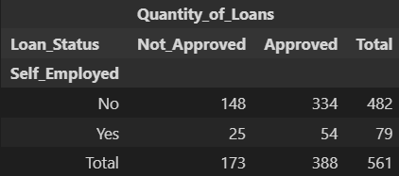
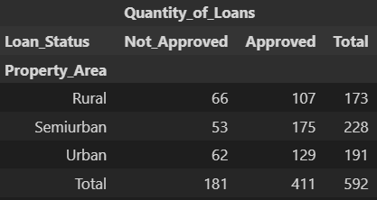
EDA

Slide 5
Results
Model: Random Forest Classifier
Metric | Value
Accuracy | 0.723
Precision | 0.699
Recall | 0.658
F1 Score | 0.666
Hyperparams: Accuracy = 0.777

Slide 6
Challenges
Time constraint (10 hours notice).

Slide 7
Thank you

